Slide 1
Monash University Fintech Boot Camp – Project 2
Algorithmic Trading - Crypto Currency
Ashwin Rao
Palmy Song
Matthew Tsiglopoulos

Slide 2

Motivation/Summary
1
2
3
What ML models can we use to build an algorithmic trading system for cryptocurrency
What are the key indicators we can use within our ML models
Out of the models developed which is the most appropriate
Questions
To determine the best ML model for cryptocurrency algorithmic trading
Core Motivation
3 Stage Analysis
A monthly suburb highlight, blooming and booming the city once again
Conduct data collection using yfinance API, and then clean/wrangle this data before use
Utilise machine learning models on various technical indicators
Compare model metrics to identify most appropriate model
Analysis
Random Forest Regressor and Classifier most suitable
SVM and Logistic Regression Model inaccurate
Findings

Slide 3

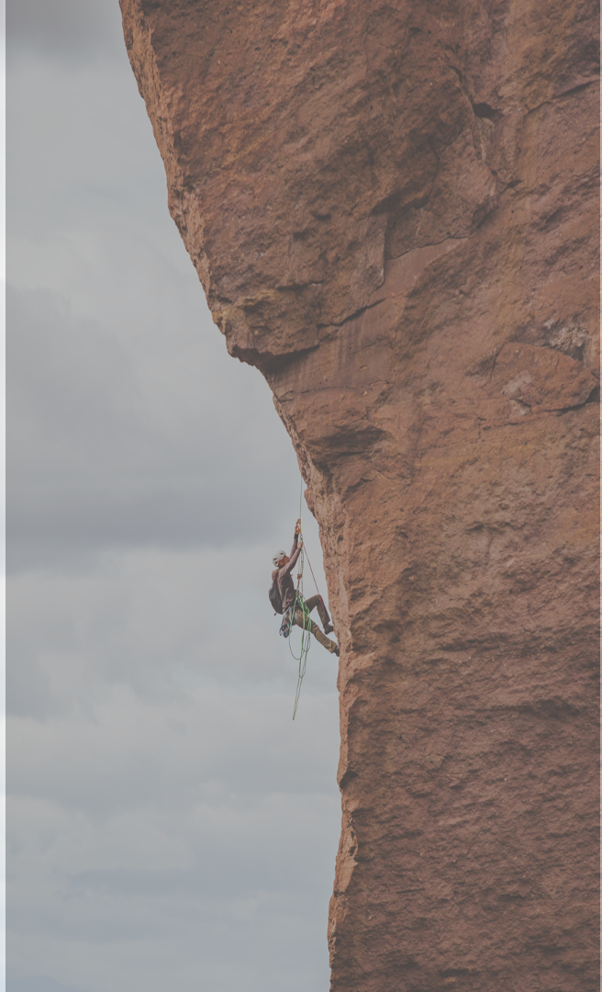

1
2
3
Data Collection
Create a trading algorithm
ML
Utilised yfinance API to collect 3 year historical data for the following cryptocurrencies:
BTC-USD
ETH-USD
BNB-USD
XRP-USD
Used this trading model to create a ML Algorithmic Trading models using:
SVM Model
Logistic Regression Model
RandomForestRegressor and classification Model
Use this data in order to create a trading model using the SMA fast and SMA slow indicators

Slide 4
| Data Used

Slide 5
Questions and Data
Our Methodology
Model 1
Model 2
Model 3
SVM Model
Logistic Regression
RandomForestRegressor and Classification
Import the data from finance
Normalized data
Create the SMA trading algorithm using rolling technical indicators from the pandas library
Import SVM Model from sklearn
Fit the model and predict values
Print out the classification report
Backtesting the model
Import the data from finance
Normalized data
Create the SMA trading algorithm using rolling technical indicators from the pandas library
Import LogisticRegression from sklearn
Fit the model and predict values
Print out the classification report
Backtesting the model
Import the data from finance
Split X and y by train_test_split function
Import RandomForestRegressor from sklearn
Fit the model and predict values
Visualised data by scatter plot
Compute the metrics for the linear regression model (r2,mse,rmse,std) and classification report for classification model
Backtesting the model
Data Used
Data Used
Data Used
Used 3 year historical closing price data for the following cryptocurrencies
Bitcoin
Ethereum
XRP
BNB
Used 3 year historical closing price data for the following cryptocurrencies
Bitcoin
Ethereum
XRP
BNB
Used 3 year historical closing price data for the following cryptocurrencies
Bitcoin
Ethereum
XRP
BNB

Slide 6
Data Cleanup/Preparation
Data Clean Up/Preparation | Why we did this
We normalized the data by divide the data by the first row | Because the prices of cryptocurrencies are various differences price-level
Created separate a column within DataFrame for daily returns using .pct_change() for each crypto | This was to be used for our technical indicators
Created separate columns within DataFrame for signal | This was to be used as a technical indicator
Only used three year historical crypto data | This was to ensure that we accounted for the fact that covid caused volatile prices

Slide 7
| Analysis

Slide 8
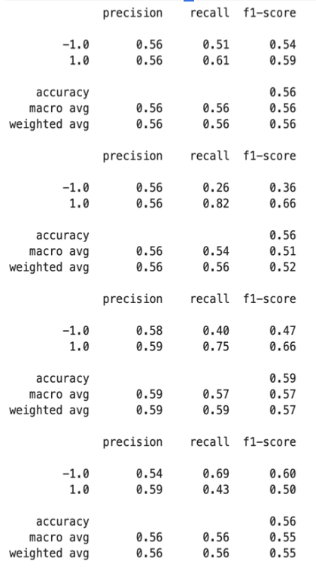
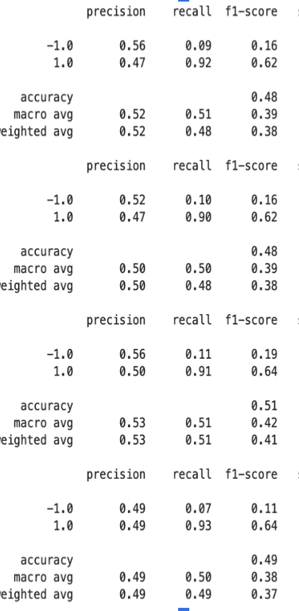
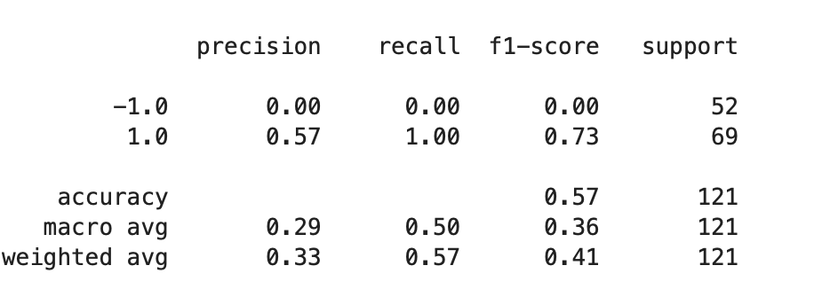
SVM Model
A
Preparing SMA Technical Indicator
B
Model Adjustments
C
Model Metrics from Training and Backtesting
sma_fast 50,sma_slow=100)
Set the X value to be the SMA fast and slow variables
Set the Y value to trading signal which initially produced a 1 when returns > 0 and a -1 when returns < 0
Fit in the model and predict values
Conduct Backtesting
Model initially flawed as -1 indicator not being trained for ETH within ML training
Adjusted model to include greater proportion of total data in training. Increased from 4 months to 10 months.
Model Metrics
Backtesting Metrics
BTC
ETH
BNB
XRP

Slide 9
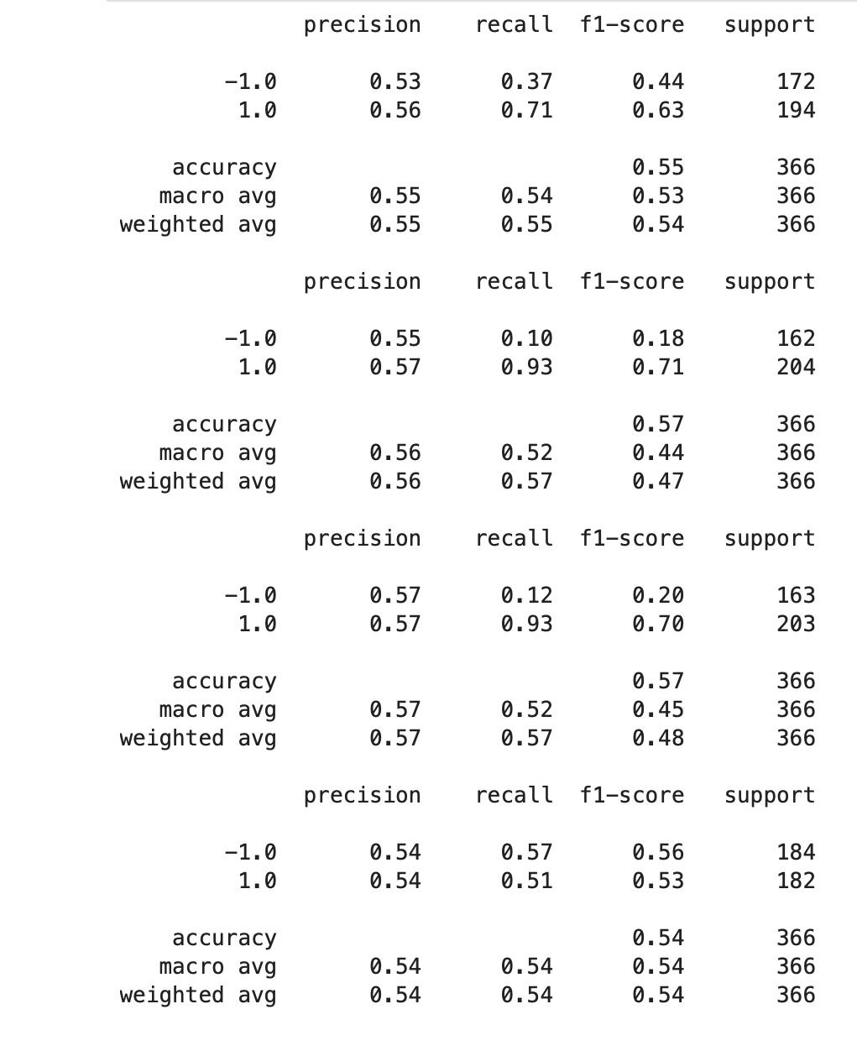
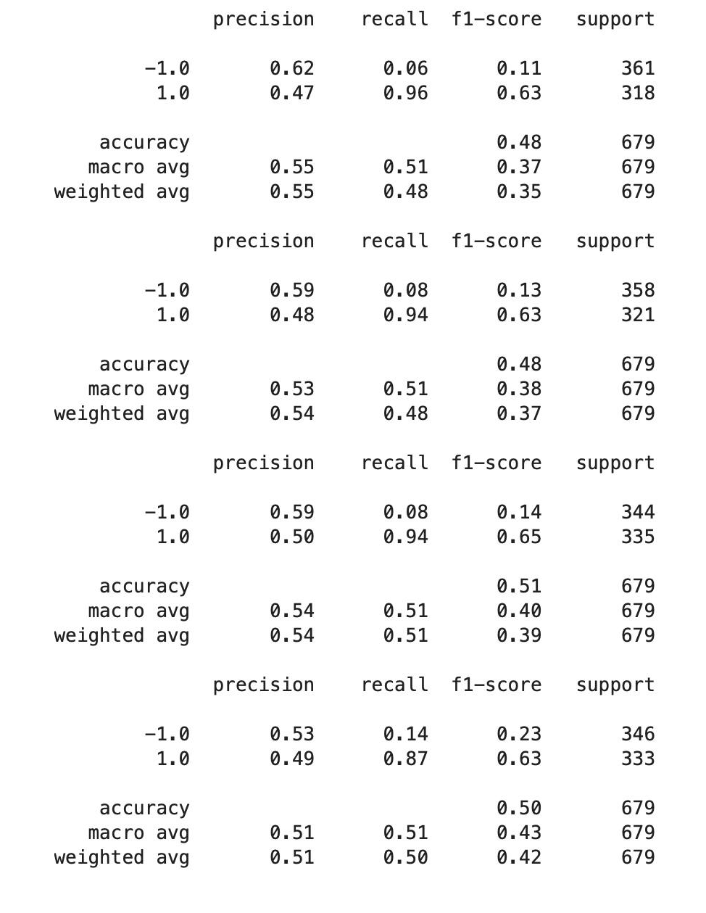
Logistic Regression
Use the normalized data instead of doing a scale processing
Create the SMA trading algorithm using rolling technical indicators from the pandas library.(sma_fast = 50,sma_slow=100)
Set the X and y values
Fit in the model and predict values
Classification report in order to evaluate the model performance
Backtesting a Machine Learning Trading Algorithm
Evaluate the model
Classification report based on training data
Backtesting report
Note: iterate the model with SMA trading algorithm using technical indicators from the finta library; the result provided more accuracy on training dataset, however; ETH and BNB datasets have none correctly predictions on -1 class

Slide 10
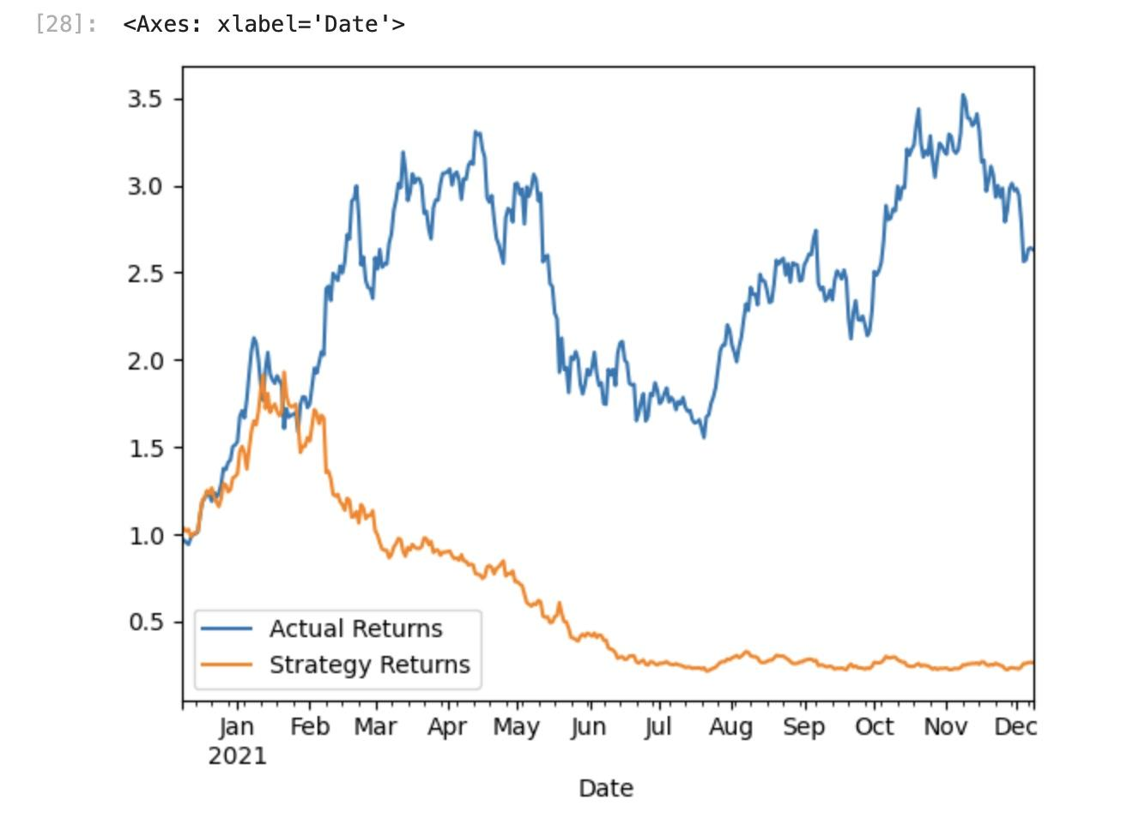
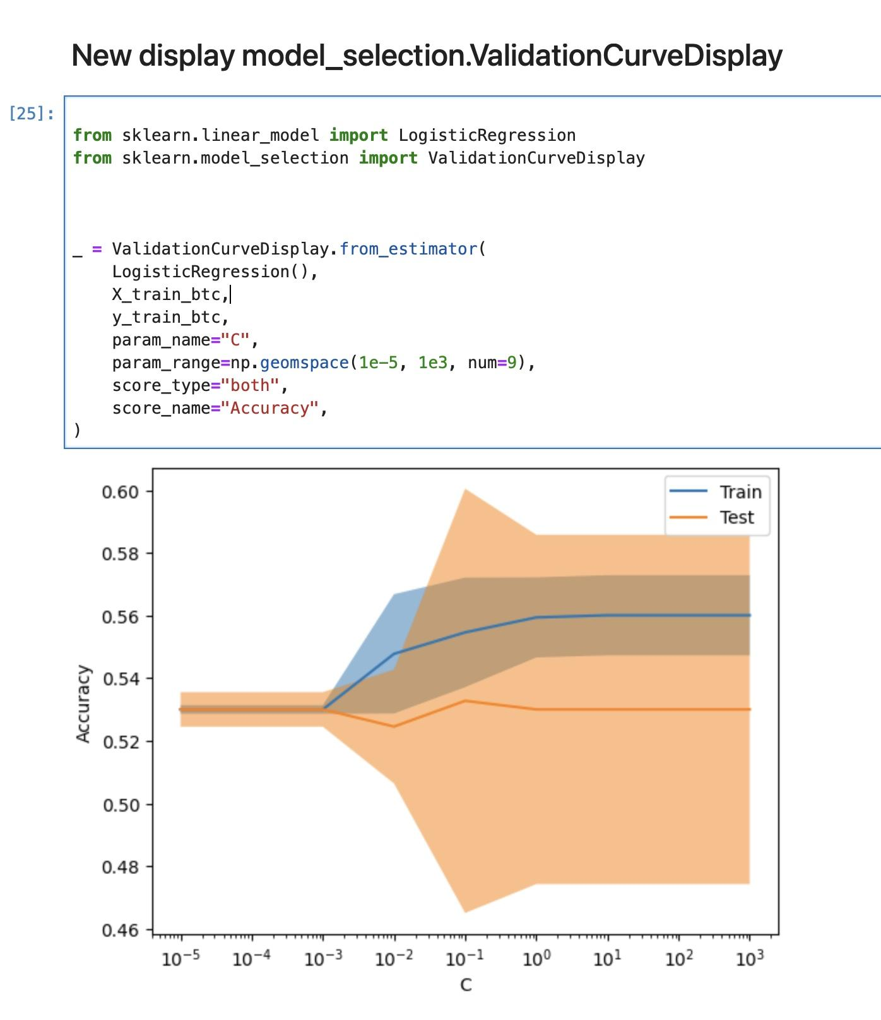
Logistic Regression

Slide 11
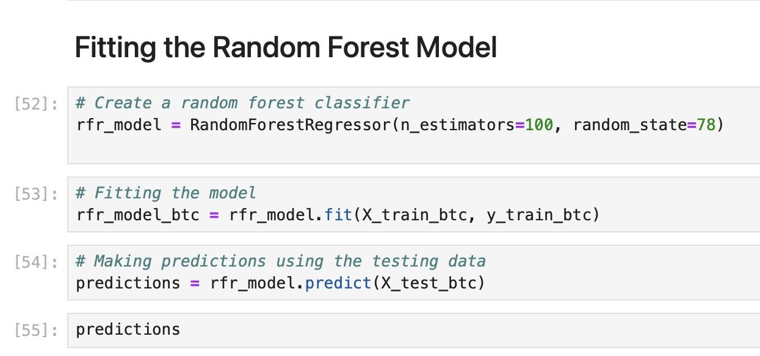
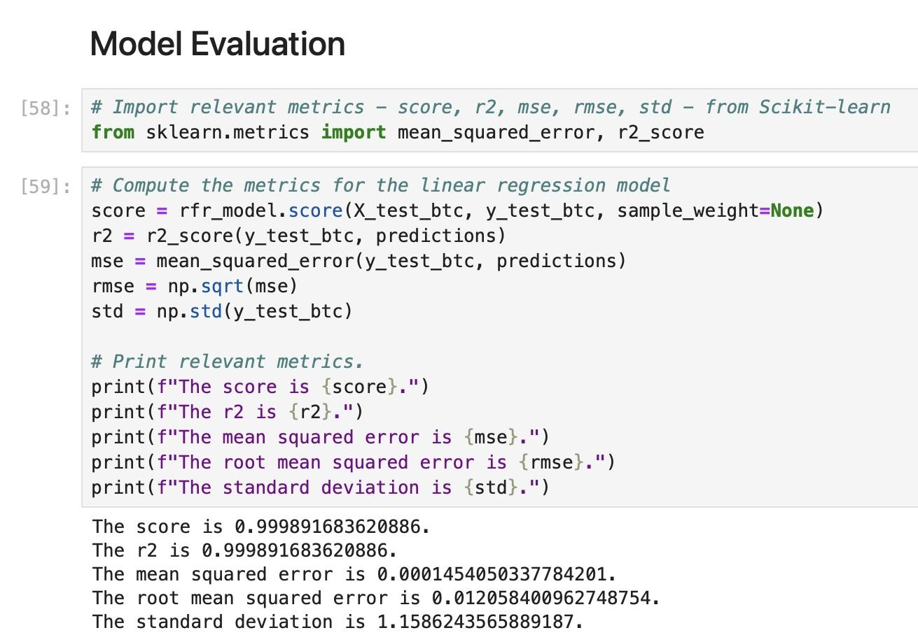
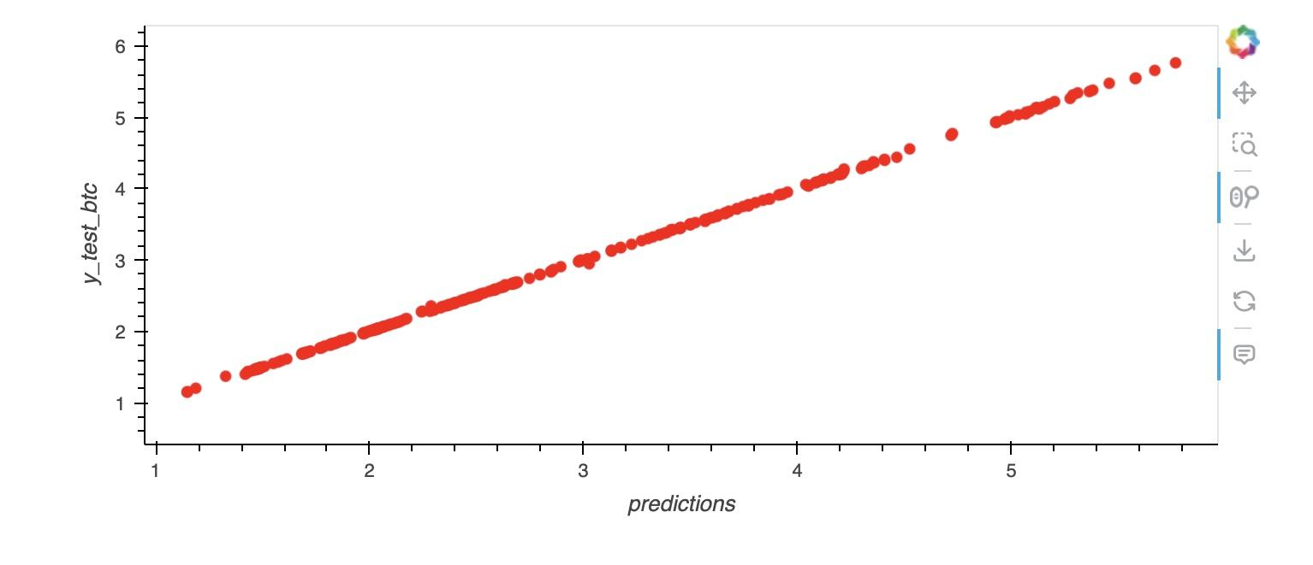
Random Forest Regressor

Slide 12
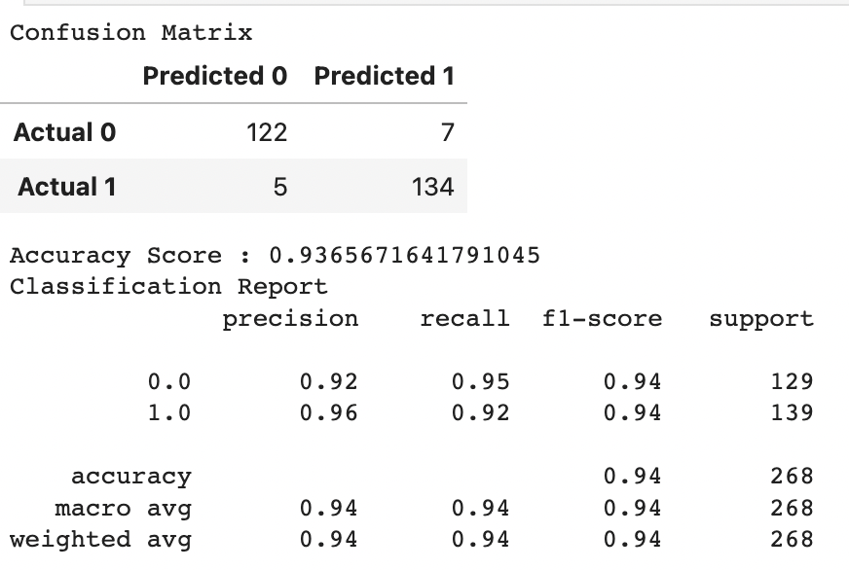
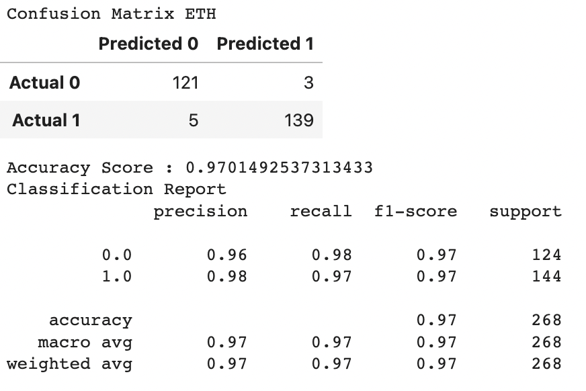
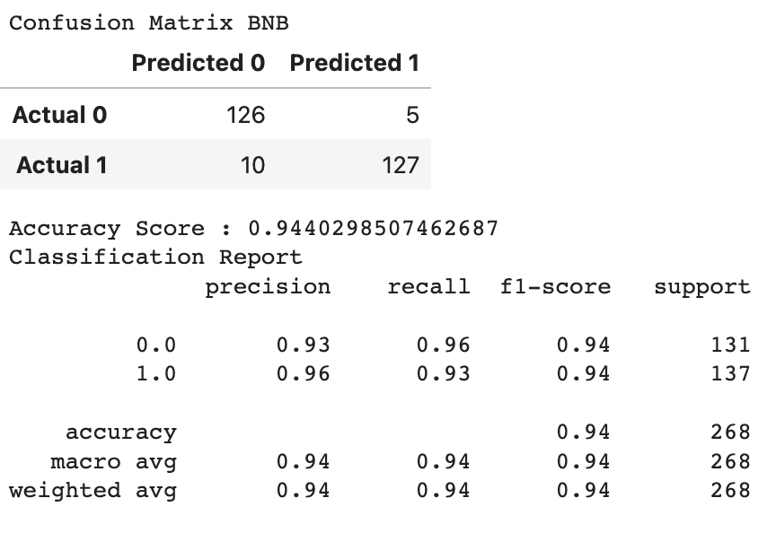
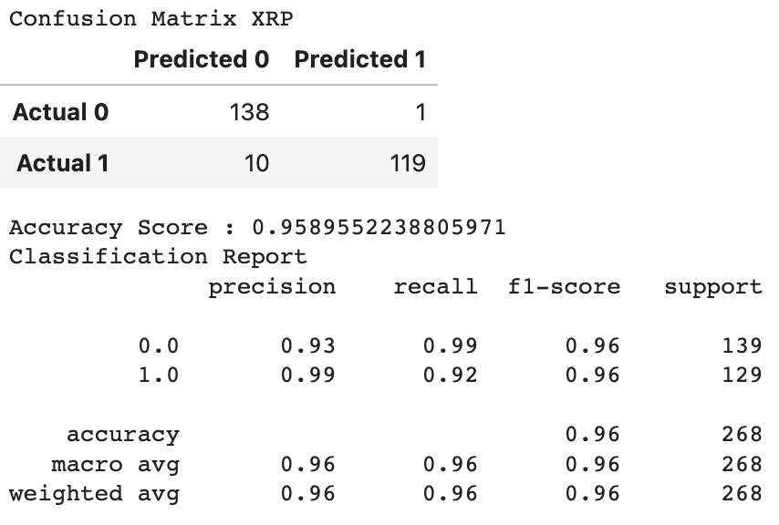
Random Forest Classifier
Undertook a scaling process for each of the cryptocurrencies
Create the SMA trading algorithm using rolling technical indicators from the pandas library.(sma_fast = 5,sma_slow=20)
Set the X and y values
Fit in the model and predict values
Classification report in order to evaluate the model performance
Backtesting a Machine Learning Trading Algorithm
Evaluate the model

Slide 13
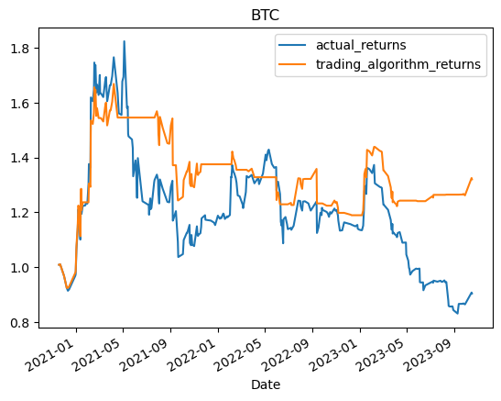
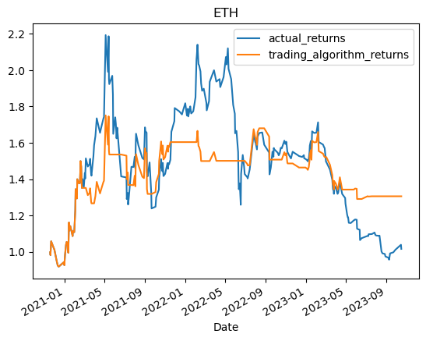
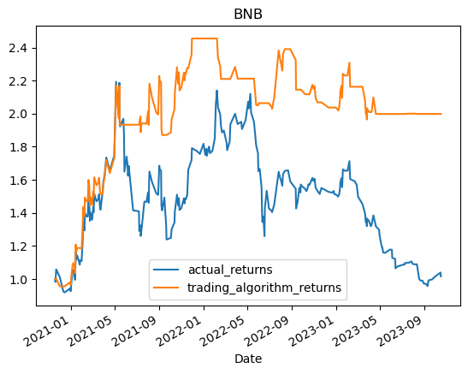
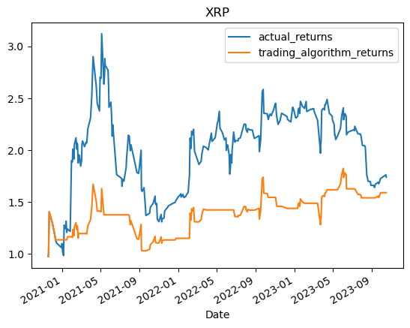
Random Forest Classifier Output - on test data

Slide 14
Comparison of 3 Models Based On Training
 | Regression Model | SVM Model | Random Forest Classification
BTC F1-Score | 0.55 | 0.56 | 0.94
ETH F1-Score | 0.57 | 0.56 | 0.97
BNB F1-Score | 0.57 | 0.59 | 0.94
XRP F1-Score | 0.54 | 0.56 | 0.96
Average F1-Score | 0.56 | 0.57 | 0.95
 | R^2 | Score | Mean Squared Error
Random Forest Regressor Model | 0.99 | 0.99 | 0.000145
Random Forest Classification
Model Has Greatest Performance

Slide 15
Discussion/postmortem
Important Findings
Project Difficulties
1
Both SVM model and Logistic Regression Model were very poor
Challenging to find a ways to improve accuracy of models
Difficult to find a balance between training and testing
Finding explanatory variables and balancing this with machine learning algorithms
2
The recall on -1 signal was especially low in
these two models
Future Steps
1
Conduct resampling in order to improve accuracy of SVM and Regression models
3
Improved accuracy when using a new technical indicator in the Random Forest Regression
2
Utilise more technical indicators within the trading algorithms

